Slide 1
Rockbuster Stealth LLC
https://public.tableau.com/app/profile/manisha.shah2622/viz/RockbusterProject_16499530758420/RockbusterProject?publish=yes

Slide 2

Who is Rockbuster?
Rockbuster Stealth is a movie rental company with stores all around the world.
Facing competition from streaming services, the Rockbuster management team is planning to use its existing movie licenses to launch and online video rental service

Slide 3
What are the objectives?
What was the average rental duration for all the videos?
Which countries are Rockbuster customers based in?
Where are customers with a high lifetime value based?
Do sales figures vary between geographic regions?

Slide 4
Key statistics for rentals
 | Rental rates | Rental duration | Replacement cost
Minimum | $.99 | 3 days | $9.99
Maximum | $4.99 | 7 days | $29.99
Average | $2.98 | 5 days | $19.99
This information is based on 1000 movies that are within the database. This information is useful as it will help the Rockbuster management team to decide on how much new content to add each month based on how long the customer is renting the movie

Slide 5
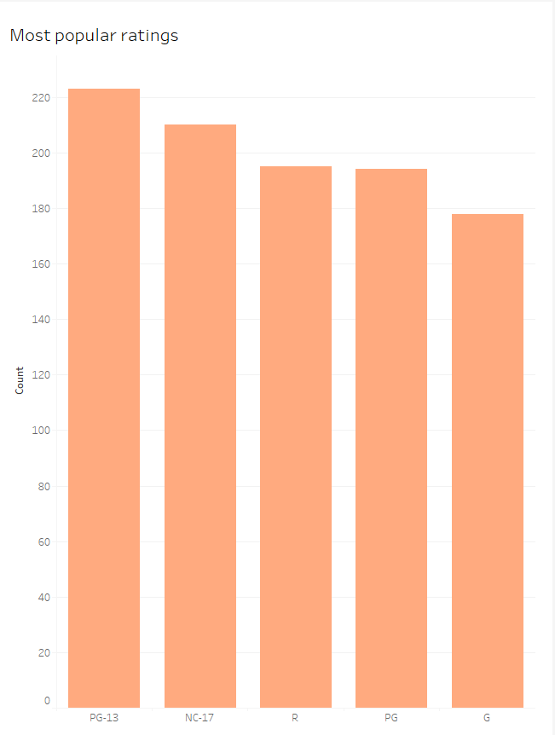
Which are the most popular ratings?
It is clear that the most popular rated movies that are being watched by customers is in the PG-13 categories.
Moving forward, more focused can be placed on this particular category when launching movies

Slide 6
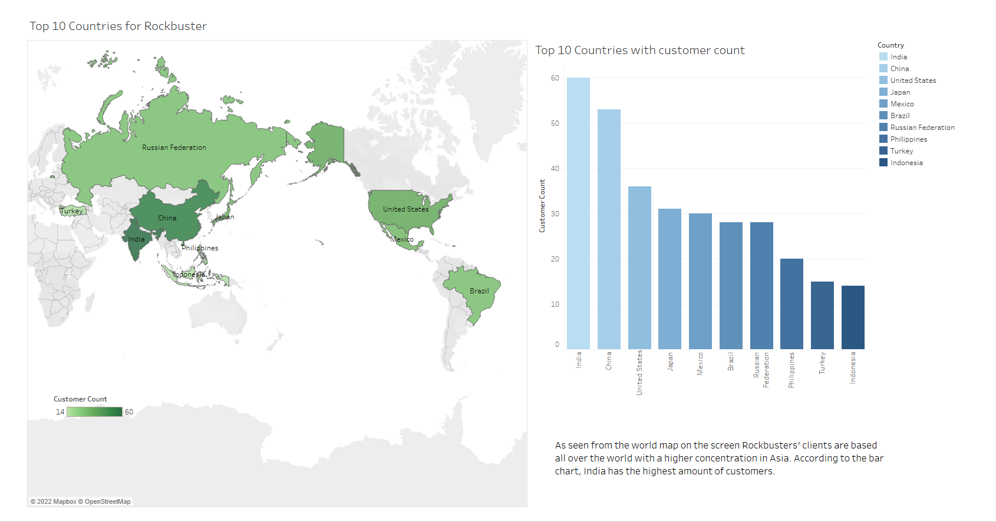
What are the top 10 countries?

Slide 7
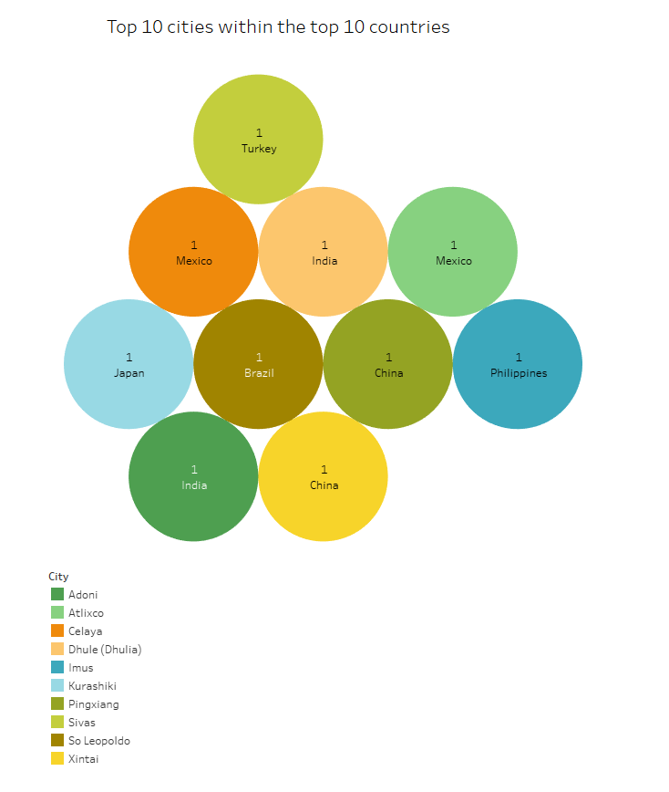
Which are the top 10 cities?
Here is representation of the top 10 cities within the top 10 countries that was shown in the previous slide.
This slide also shows us which cities have the most customers by count
This allows us to see that Rockbusters customers are spread widely throughout the different cities.

Slide 8
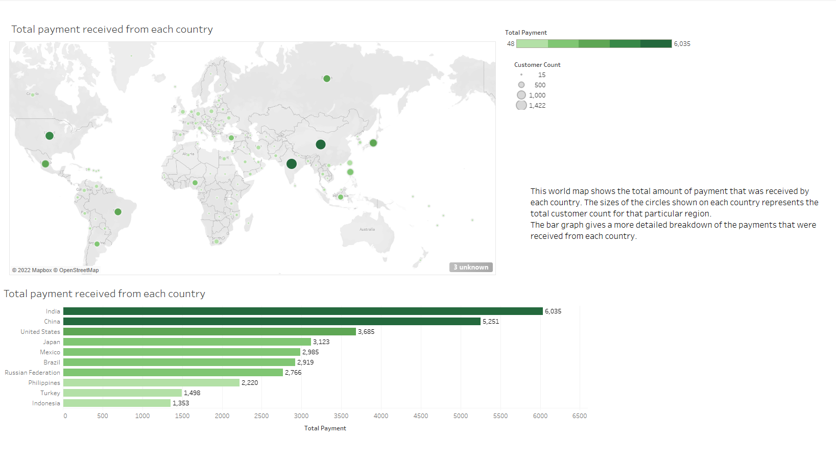

Slide 9
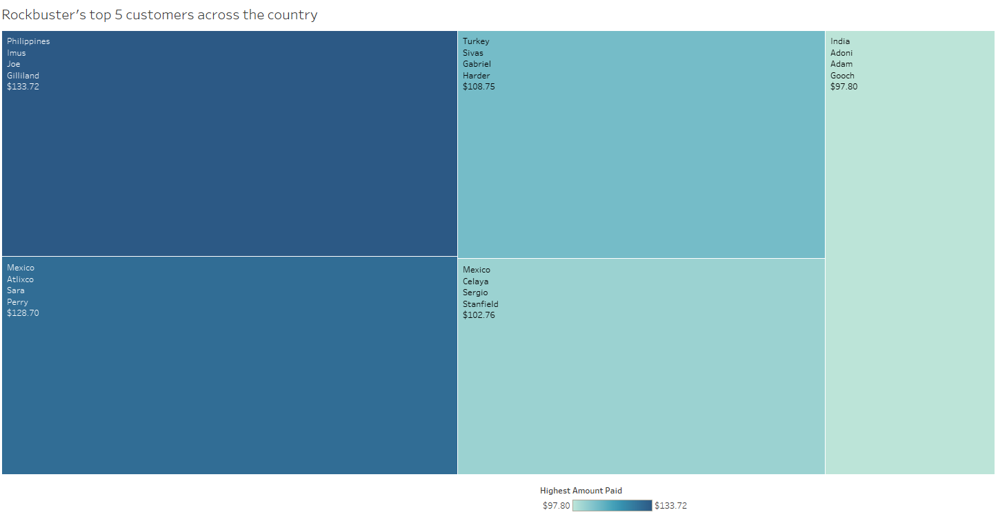
Who are the top 5 customers?
This chart here gives Rockbuster a quick breakdown of their top 5 loyal customers and where they are located within each country.
It would be in Rockbuster’s best interest to create a loyalty program that offers rewards after a certain percentage of sales has been reached to ensure their customers are happy and keep returning.

Slide 10
Recommendations:
Based on the statistics, focus for streaming should be placed on countries such as India, China and the United States since they seem to be the most popular areas
Focus should also be placed on other areas that are not as heavily targeted to establish a reasoning for the low audience (are their factors that are hindering the customer, if so what are they?)
Loyalty programs put into place for existing customers and future customers should potentially attract more revenue.
We already know that PG-13 rating is the most popular, however, introducing a wider range of movies in other categories might give the other ratings a boost as well. (Ex: what types of movies are shown in rated R movies: action, sci-fi..etc.)

